Slide 1
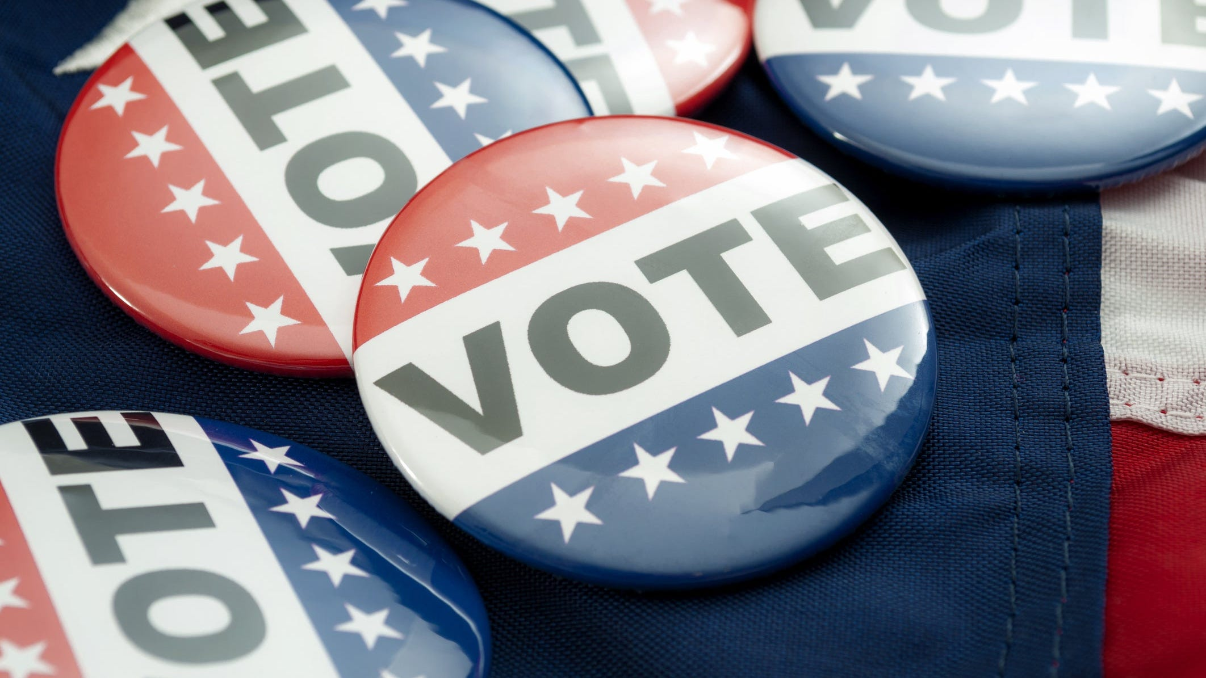
Impact of campaign funds on election results
Group 4

Slide 2


Our Team
Jiayu Zhang
Shubham Agarwal
Nitesh Wagh
Nityanand Kowtha
Rajib Mahato

Slide 3

Overview of the Case
Does spending money influence the election results?
Dataset
1814 records of US Election Congressional information of 2015-16
Approaches
Explore data sets and analyse campaign expenditures and campaign durations at the state, district, and district level

Slide 4
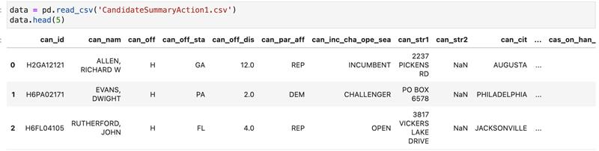
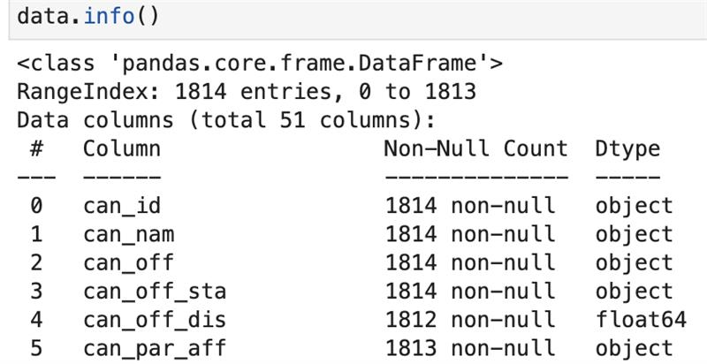
Data Set

Slide 5
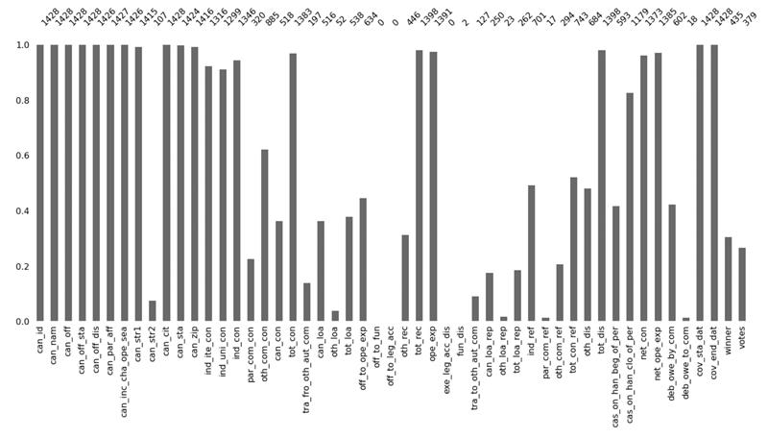
Issues With Data
Limitation of data for Senator and presidency variables as 78% of the data is for House of Representatives
Columns with no data and null values
In the winner column, only the winners were marked as ’Y’

Slide 6
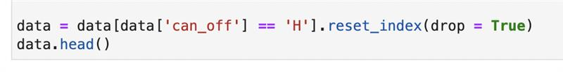
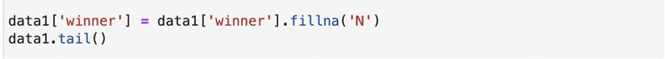

Data Cleaning
Selecting House of Representative election data among HoR, Senators and Presidency election
Replacing the missing values for people who lost in the Winner column with N
Dropping rows which has missing data

Slide 7

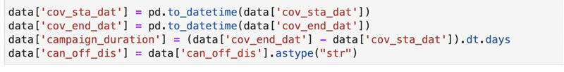
Data Cleaning
Converting the net operating expenditure to a float data type
Creating a new column to capture total campaign duration
Selecting columns for further analysis

Slide 8
Questions
Does spending extravagantly in elections influence election results?
If No, Do we have any outlier where the representative won while spending less money ? Could Party affiliation be the reason?
If Yes, Amount of money spent on State level and Congressional district level?
Does party affiliation play’s any role in Election results?
Does campaigning for longer time influence election results?

Slide 9
Does spending extravagantly AND CAMPAIGNING influence election results?

Slide 10
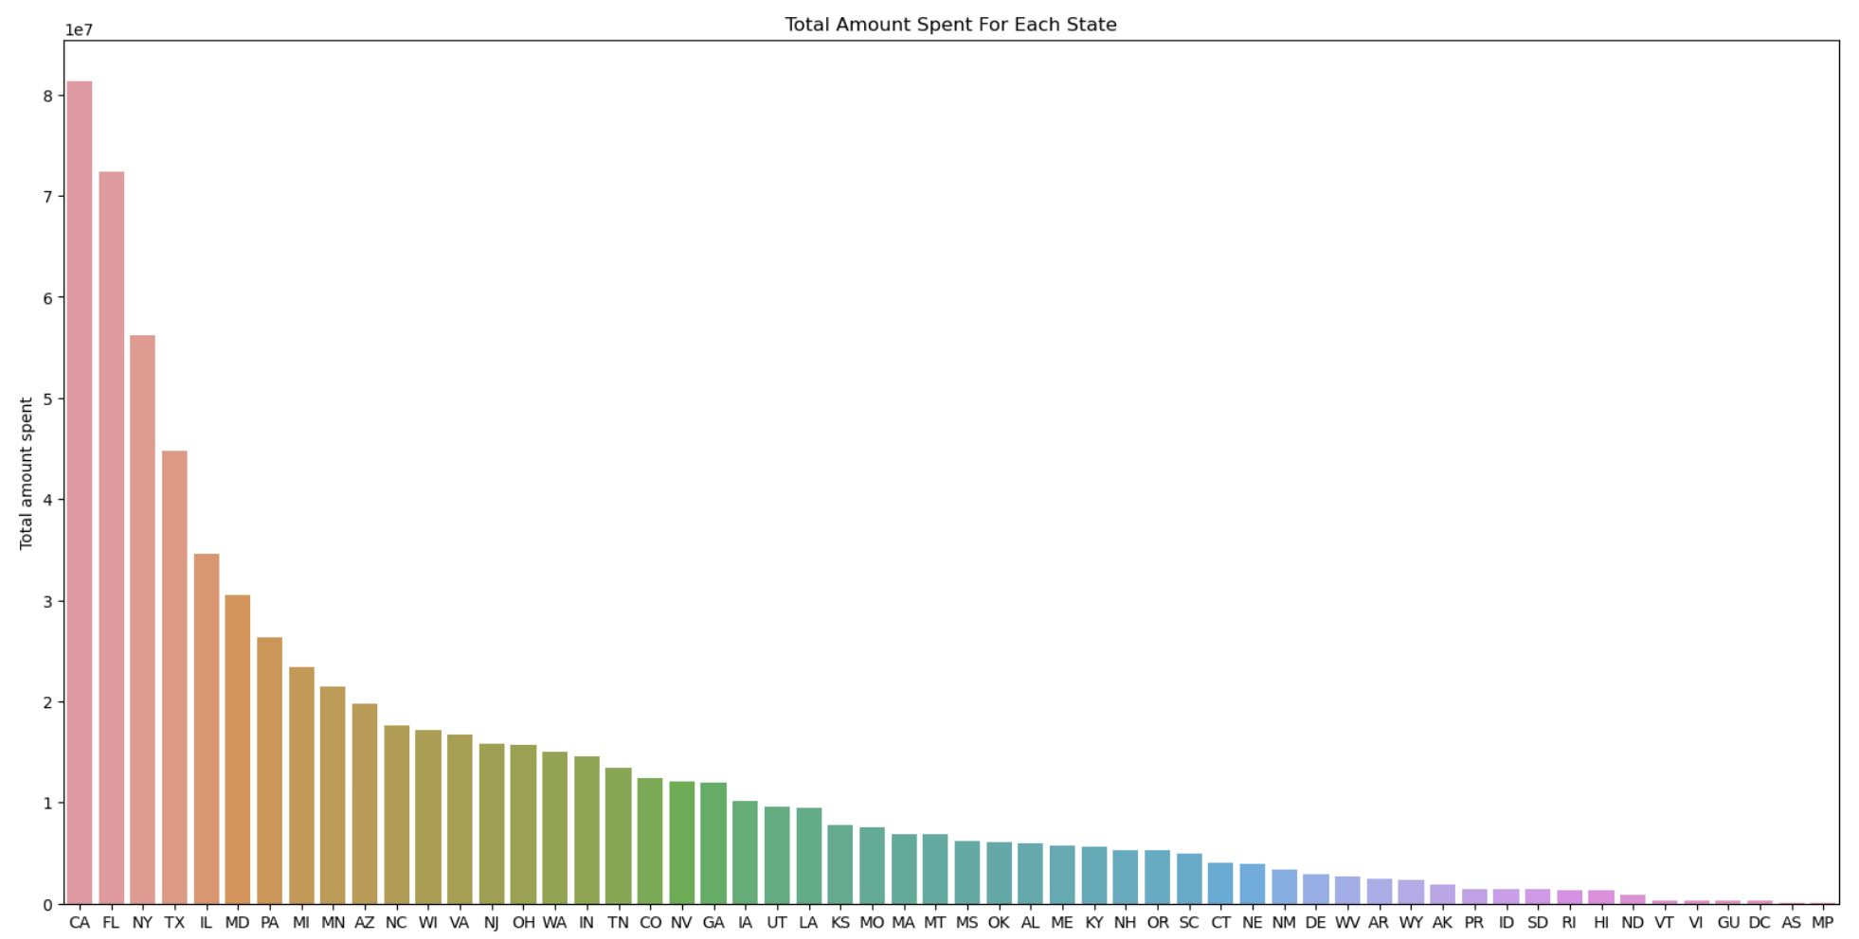
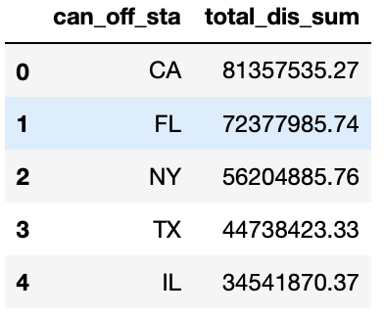

At State Level

Slide 11
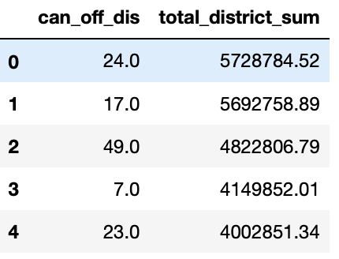
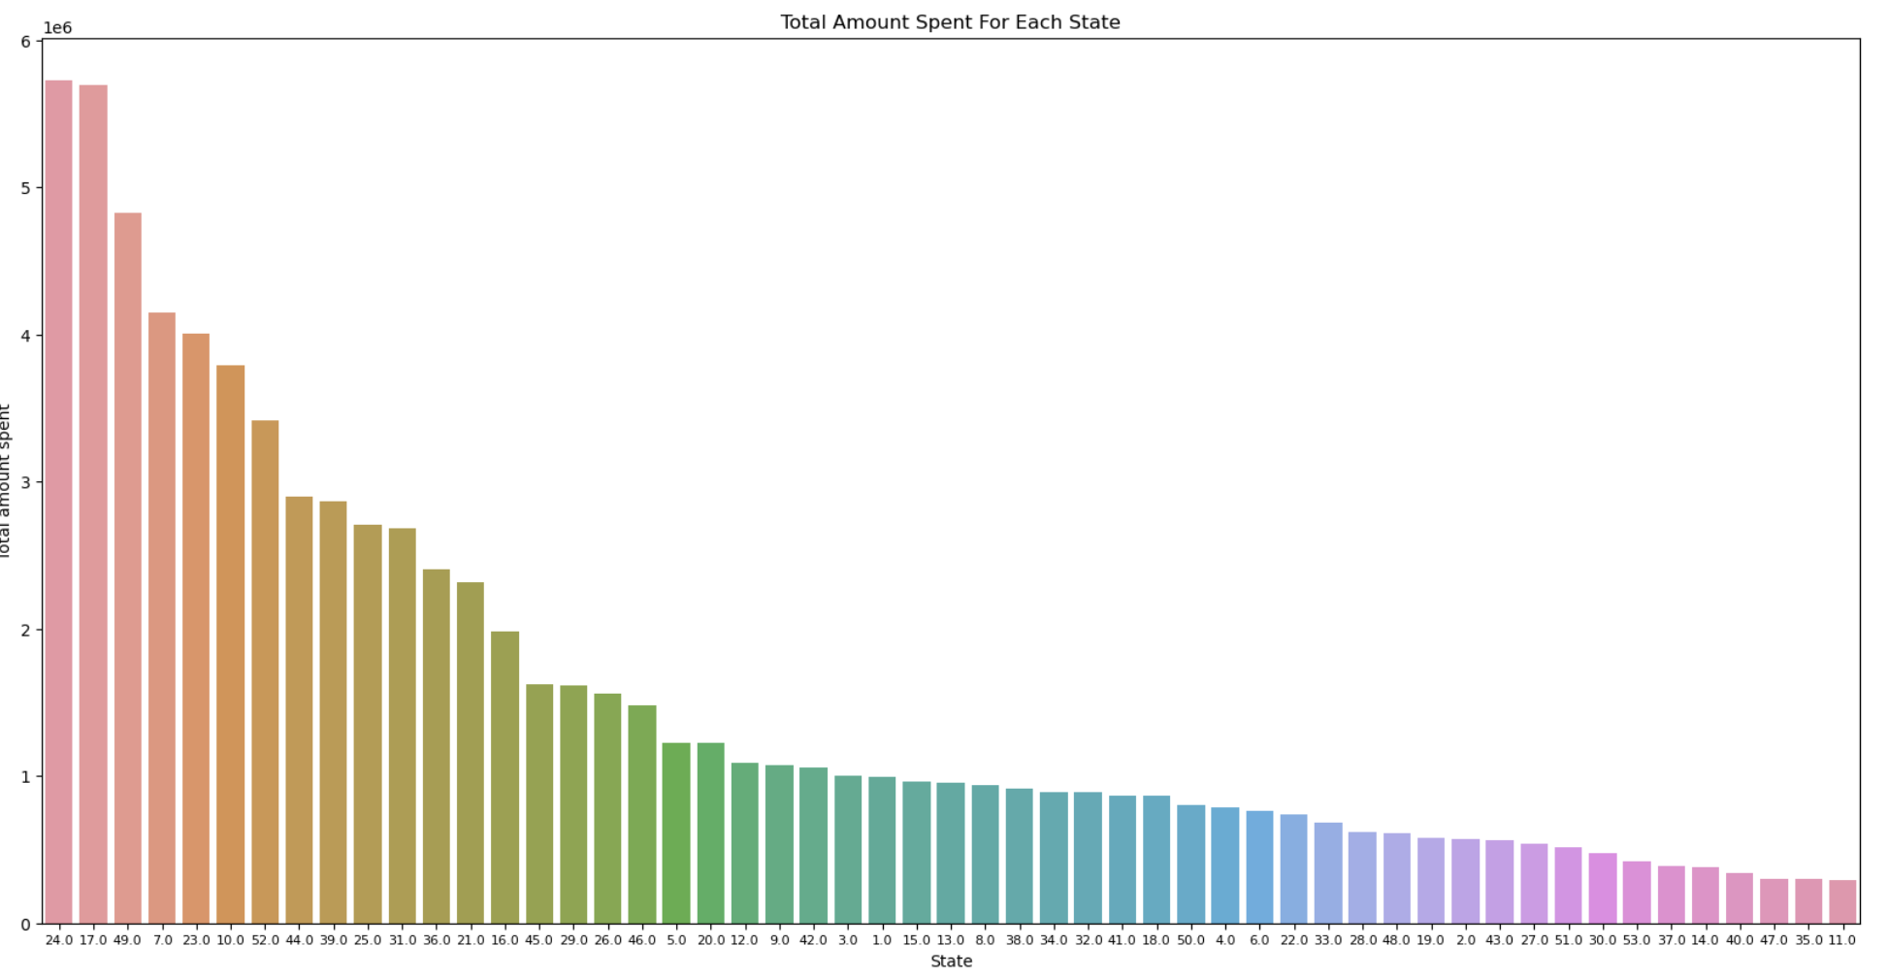
At Congressional District Level For State California, which district the maximum amount of money spent?

Slide 12
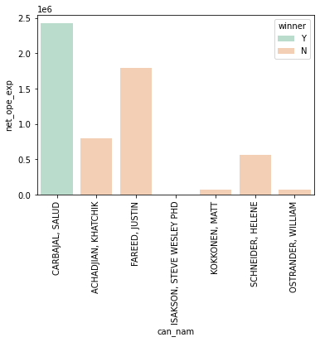
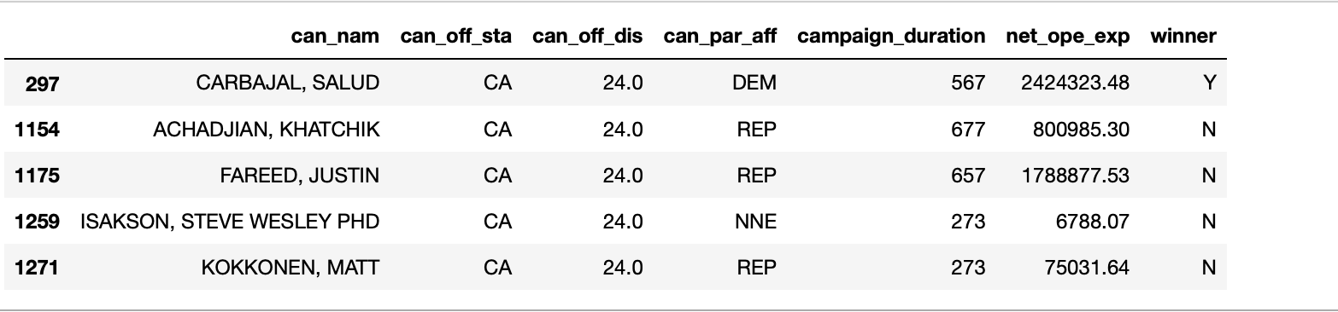
Did the Candidate win in District 24.0 in California State ?

Slide 13
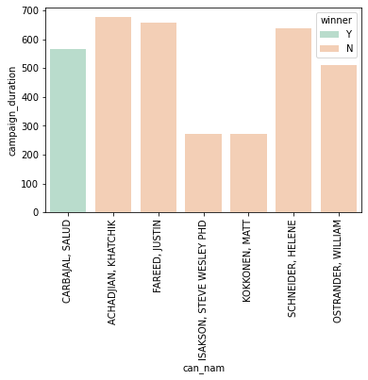
How long did the winner campaign in District 24.0 in California?

Slide 14
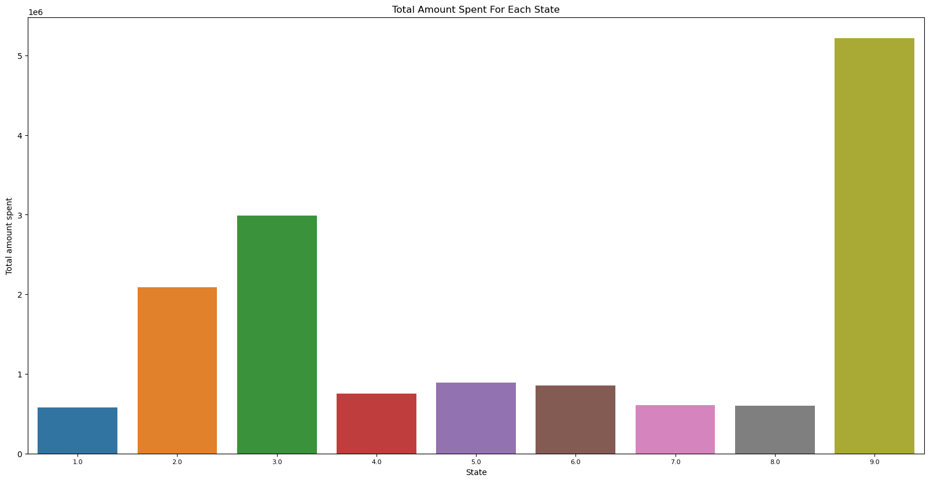
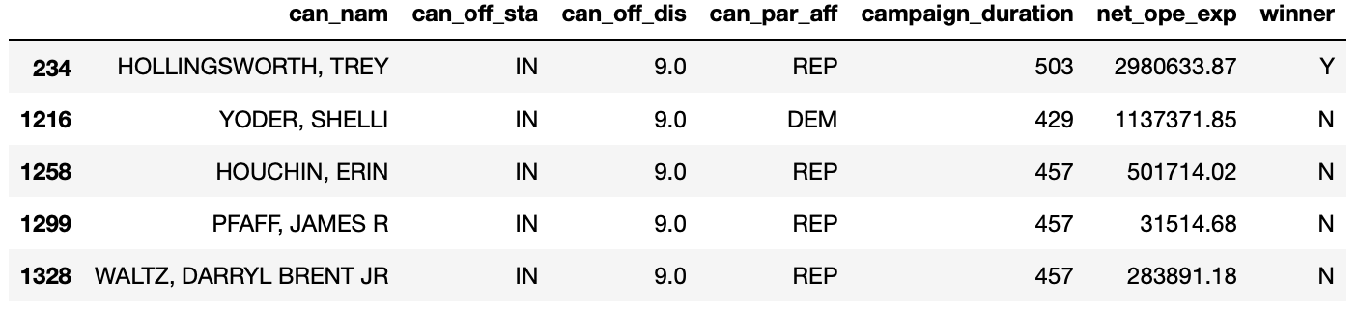
At Congressional District Level For State Indiana, which district the maximum amount of money spent?

Slide 15
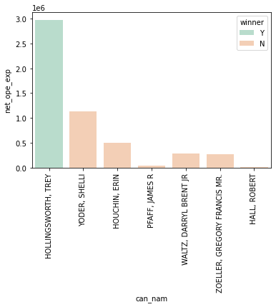
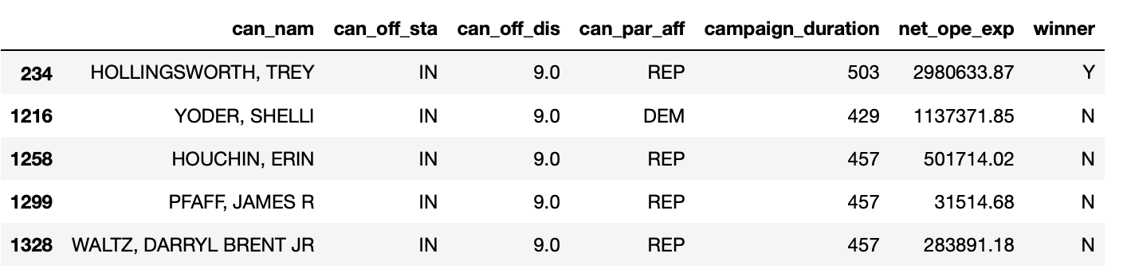
Did the Candidate win in District 9.0 in Indiana State ?

Slide 16
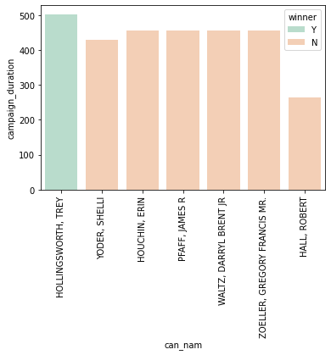
How long did the winner campaign in District 9.0 in Indiana?

Slide 17
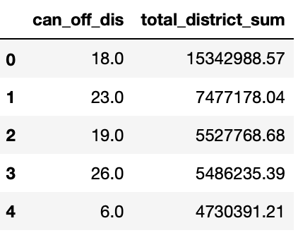
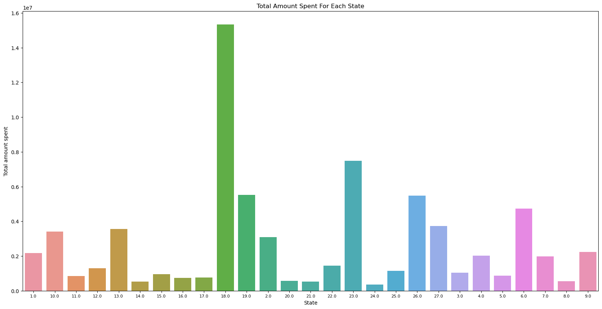
At Congressional District Level For State Florida, which district the maximum amount of money spent?

Slide 18
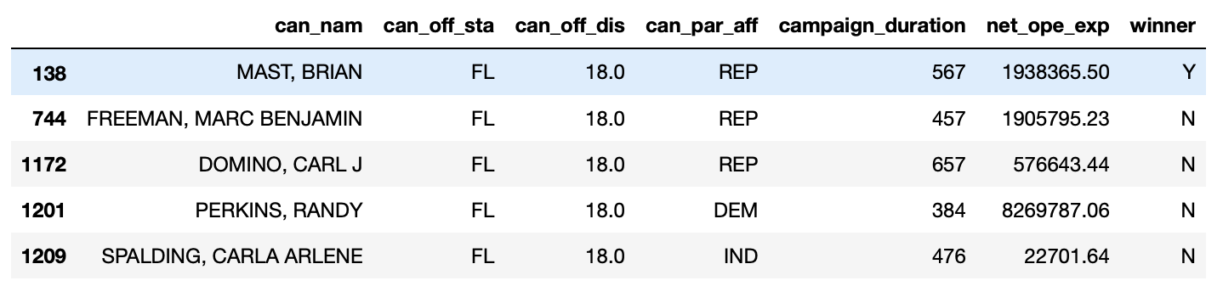
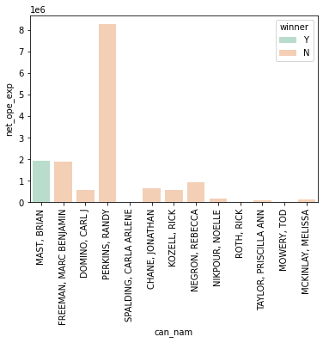
Did the Candidate win in District 18.0 in Florida State ?

Slide 19
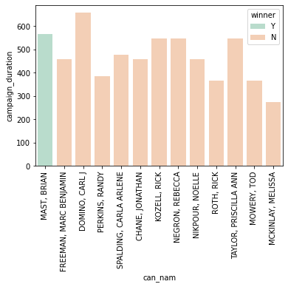
How long did the winner campaign in District 18.0 in Florida?

Slide 20
Creation of predictive Modelling

